Slide 1





Slide 2



x
Vision
A world where educators succeed and students thrive, everywhere learning occurs.
Mission
We create innovative, proven learning technology, partnering with educators to ignite student potential.
Values
We place educators first
Our purpose is what fuels us
We create positive impact
Our people are our heart
We lead with respect and trust
Empathy guides our actions
Diversity and inclusion
strengthen us
Notes:
Bringing it all together...

Slide 3

why virtual?
Build School Around the Needs of Students
Recover credits to meet graduation goals
Expand options into courses a school may not offer
Fill a course-specific need due to teacher shortage
Get ahead in a flexible, virtual environment
Total schedule flexibility in a fully virtual school
Address social factors: bullying, violence, etc.
Meet specific needs: homebound, IEP, Student Athlete (NCAA Approved)
Bring students back to your district to recover ADA

Slide 4

What is EdOptions Academy?

Slide 5
A Fully-Accredited Virtual School Program
EdOptions was founded in 1997 to create outstanding web-based educational programs that support students and teachers inside and outside the traditional classroom.
To do this, Edmentum partners with schools and districts to deliver rigorous and research-based virtual courses built to state and national standards.
Taught by high-quality, state-certified teachers experienced in effective synchronous and asynchronous online instruction and support.
Flexible program implementation and management designed for virtual learning
End-to-end managed educational services
Accredited by Cognia (Formerly AdvanceEd)
90%
passing rate
80%
course completion
200K+
enrollments annually
500+
full time teachers &
150+ part time teachers

Slide 6
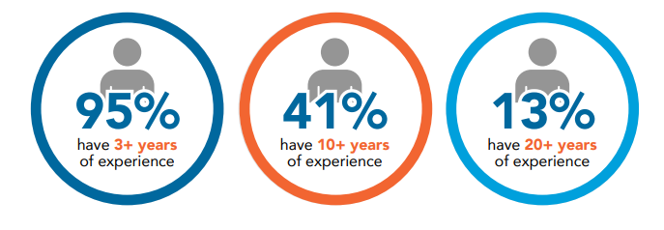
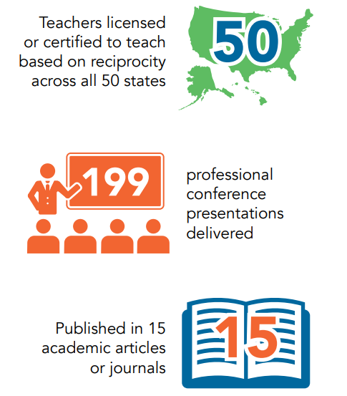
High Quality Teachers and Instructional Supports
Supports Available within our standard instructional model:
Access to structured online courses, 24/7/365; target due dates to ensure pacing
Access to recorded lessons, study guides, and teacher-curated course-aligned materials
Live Lessons offered based on a set schedule, offered to all EdOptions students
  6-12 are offered weekly
  K-5 are offered daily Mon-Thurs
  Enhanced synchronous options available
Daily Live Help available for students during core school hours (core content areas)
Access to Teacher office hours
Teacher communication via email, phone, and text (within 24-48 hours)
Feedback on graded work within 48 hours
Regular Progress Reports
OnDemand Access to grade and student activity via Genius SIS
Parent Access and Communication with teachers
IEP/504 Support
Teacher Video
Notes:
For K-5, core courses are offered daily M-Th for grades 3-5. For grades K-2, students will spend more time in ELA and foundational skills offered daily; science and SS will toggle every other day, 2 days a week, each.

Slide 7
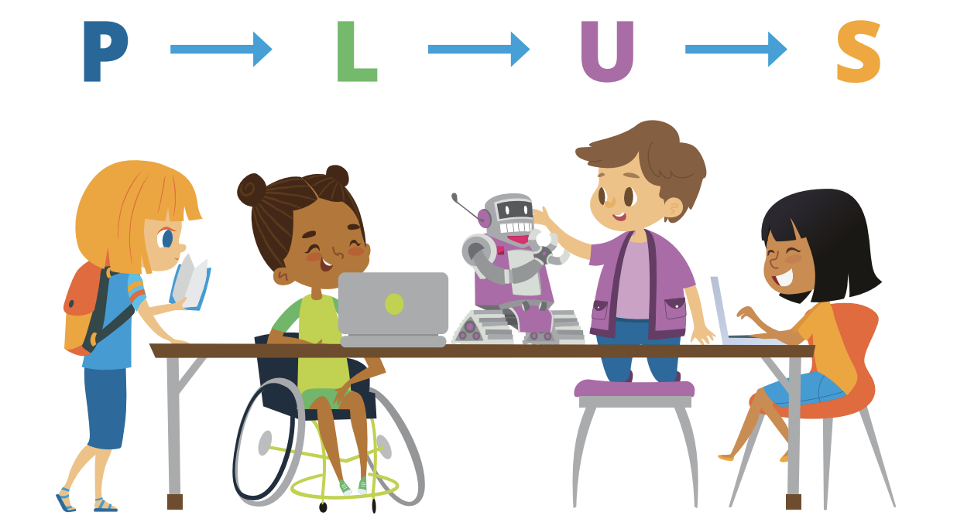
K-12 Virtual & Blended Learning
6-12 Digital Curriculum
Edmentum’s six learning design principles provide the bedrock of Edmentum Courseware’s 6-12 learning methodology. Our curriculum focuses students on content that they have not yet mastered and enables learners to work at their own pace to master new concepts and progress forward at their own pace.
Our K-12 digital curriculum is designed to support the unique learning needs and styles of K-5 and 6-12 learners. Our courses are continuously up-to-date and always aligned to rigorous state and national standards.
K-5 Digital Curriculum
Edmentum’s K-5 digital curriculum uses the research-based PLUS Framework. It actively engages students in projects that allow them to apply what they learn, use it in practical and meaningful ways, and then show it to demonstrate mastery and build confidence.
30K+
hours of instruction
400+
engaging courses

Slide 8



Spectrum of Instructional Services
On-Demand
Tutoring
Targeted Skills Instruction
Online course/virtual teacher of record services
Grading Services
Enhanced Virtual Learning aligned to bell schedules
Shared
Responsibility
Instructional Coaching
Student Success Coaching
Special Education Services
Fully Supported by Edmentum Staff
Supported by
District Staff
K-12 Digital Curriculum
Complete
Virtual Program

Slide 9
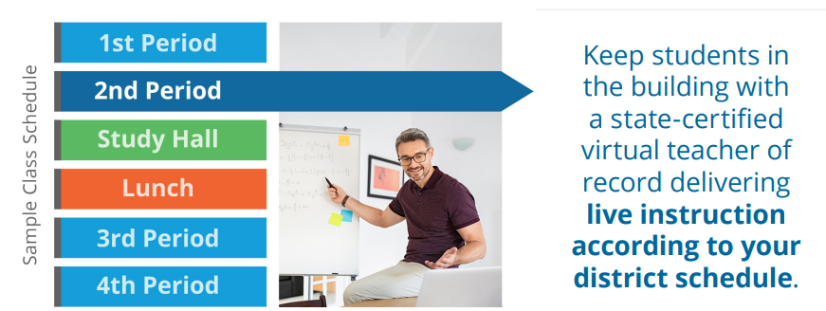
Teaching to Your Bell Schedule
Create your own recipe for live, synchronous virtual instruction across a building or district
Teacher Shortages, Maternity/Paternity Leave, Short Term Leave
Consistent Virtual teacher who leads all instruction for course
Scheduling 1-5x per week, with 4-5 recommended sessions per week

Slide 10
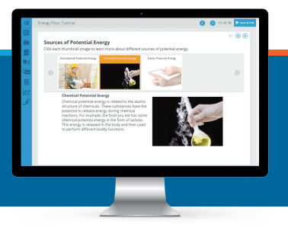
Summer School Program
$80.00 per course, per student for 4 weeks
Teacher do all the grading, keep students up on pacing, offer recorded resources and Live Help.
Used for Credit Recovery (course with pre-tests) or enrichment courses
Prepare for the transition to high school
Final Grades show up on transcripts

Slide 11

CTE Pathways
28 CTE Pathways
Health Science
Therapeutic Patient Care Pathway
Public Health Services Pathway
Hospitality & Tourism
Culinary Arts Pathway
Hospitality, Travel, and Tourism Pathway
Restaurant Management Pathway
Human Services
Cosmetology Pathway
Counseling & Mental Health Services Pathway
Family & Community Services
Pathway
Information Technology
Information Technology Support Services Pathway
Networking Systems Pathway
Law and Public Service
Law Enforcement Services and Forensics Pathway
National Security Pathway
Manufacturing
Product Design and Innovation Pathway
STEM
Advanced Sciences Pathway
Applied Engineering Technology Pathway
Automation and Robotic Engineering Pathway
Environmental Engineering Pathway
+ Pathways in:
World Languages, Humanities,
Advanced Academics
Agriculture, Food, & Natural Resources
Animal Science Systems Pathway
Environmental and Natural Resources Pathway
Architecture and Construction
Architectural Design Pathway
Arts, AV, & Communication
Fashion Design Pathway
Animation & 3D Modeling Pathway
Theater, Cinema, and Film Pathway
Journalism Pathway
Business, Marketing and Finance
Marketing and Sales Pathway
International Business Pathway
E-Commerce Marketing Pathway
Education and Training
Early Childhood Education Pathway

Slide 12
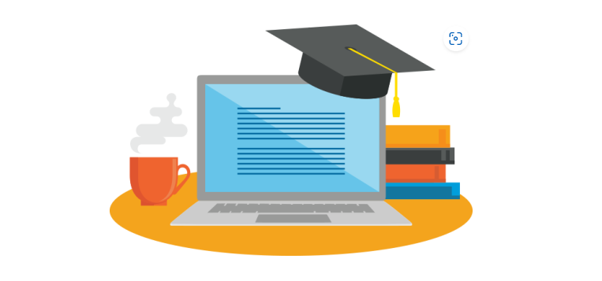
AP Courses (Advanced Placement)
Curriculum + Certified Teacher
AP Calculus, A/B
AP Statistics
AP English Literature & Composition A/B
AP English Language and Composition
AP US History, A/B
AP Biology, Semester A & B
AP Chemistry, Semester A & B
AP Environmental Science A/B
AP Psychology
AP Macroeconomics
AP Microeconomics
AP Computer Science, Semester A
AP Physical Education 1
AP Physical Education 2
AP Spanish, Semester A & B

Slide 13
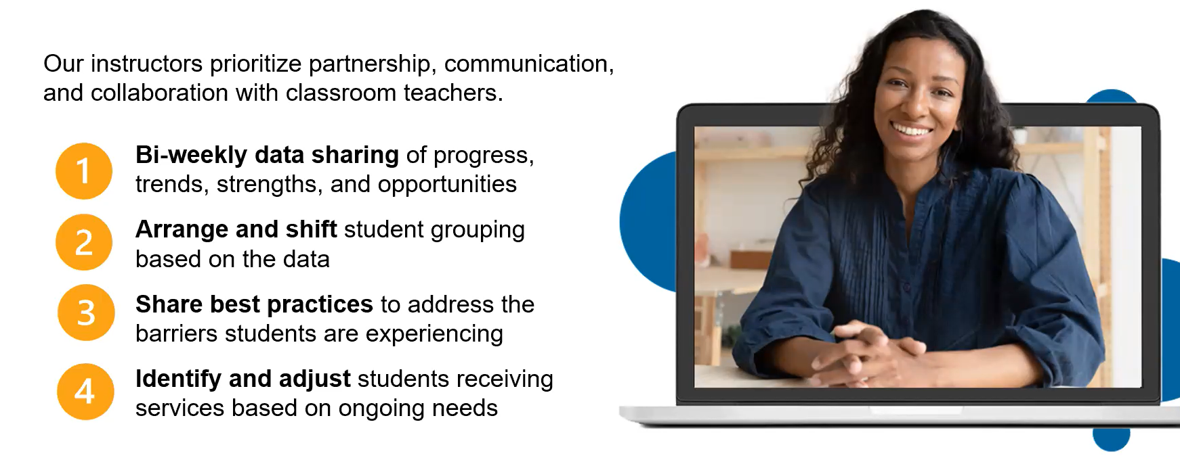
High Impact Tutoring
Targeted Small Group Instruction

Slide 14
Special Education Services
ESS Support Review
Add on for EdOptions Academy students already enrolled in program.
Works with General Education EOA Teachers to support student learning, Implement IEP Accommodations/Modifications and review IEP Goals
Exact Path Diagnostic & learning paths to scale interventions K–12 in math, reading, & ELA
Access to supported curriculum for students in grades 9-12 Supplemental Videos Sentence Starters Graphic Organizers Study Guides for Unit Tests
Provide monthly progress monitoring toward IEP academic goals
ESS Support Review + Progress Monitoring
Add on for EdOptions Academy students already enrolled in program.
Works with General Education EOA Teachers to support student learning, Implement IEP Accommodations/Modifications and review IEP Goals
Provides Monthly Progress Repots
Exact Path Diagnostic & learning paths to scale interventions K–12 in math, reading, & ELA
Access to supported curriculum for students in grades 9-12 Supplemental Videos Sentence Starters Graphic Organizers Study Guides for Unit Tests
ESS Direct Support and Review
Add on for EdOptions Academy students already enrolled in program.
Works with General Education EOA Teachers to support student learning, Implement IEP Accommodations/Modifications and review IEP Goals
Provides Monthly Progress Repots + IEP Goal Specific data
Exact Path Diagnostic & learning paths to scale interventions K–12 in math, reading, & ELA
Additional support may include Supplemental Videos Sentence Starters Graphic Organizers Study Guides for Unit Tests
Includes 30 minutes per week per student of one-on-one support focusing on executive functioning, language arts, and math skills. Additional time may be purchased as per IEP needs

Slide 15

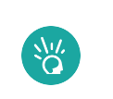
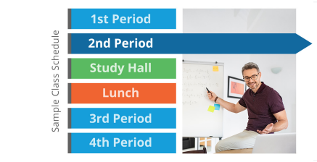



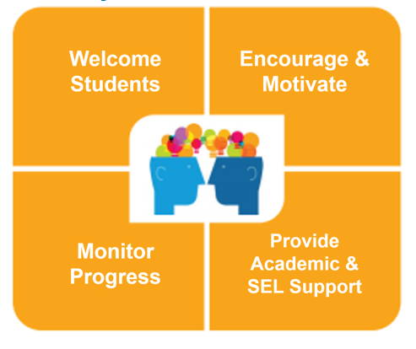

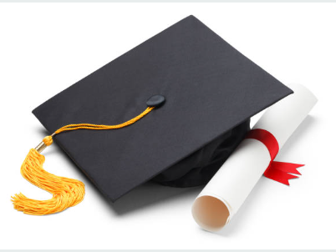
EdOptions Academy Instructional Services
Calvert Learning
Ed Options Academy
Apex Learning Virtual School
Enhanced Bell Schedule
High Impact Tutoring
K-5 Project-based elementary digital curriculum to develop critical thinking skills in young learners.
K-12 Online courses paired with State Certified Teacher to deliver effective virtual programs.
6-12 Online courses paired with State Certified Teacher to deliver effective virtual programs.
High Dosage Tutoring – 6 week consecutive, pre-scheduled time, for groups up to 8 students each.
Certified Teachers to teach to your bell schedule with our core curriculum K-12
Grading Assistant Services
Special Education Services
Success Coaching
Instructional Coaching
Diploma Services
Qualified grading assistants to help grade students work in Calvert Learning or Courseware in 48 hours.
Provide different levels of services to school district to support Special Needs Students
Provides additional layer of support to keep students on track in Grades K-12
Prepares your K-12 teacher to teach in a Virtual Classroom
Offers the students the opportunity to earn High School Diploma

Slide 16
Questions
Tina Robertson
Instructional Services Partnership Manager
PH: 952-832-1051
Email: tina.robertson@edmentum.com

